Slide 1

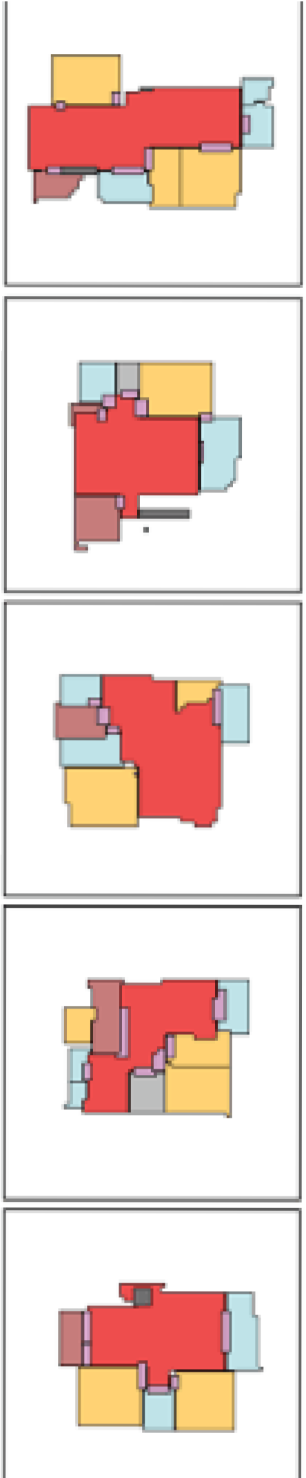
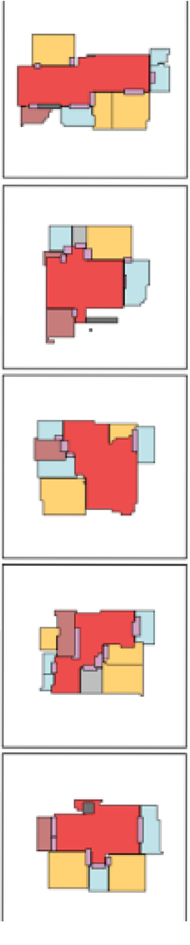

Capstone Phase B House-GAN++
Prof. Volkovich Zeev Dr. Avros Renata
Dorin Beery Mosa Hadish

Slide 2
Problem Overview
Generating floor plan with AI model

Slide 3
Experimental Phase
Experiment the model weaknesses
Inner rooms
Post training
Notes:
Present the experimental phase problem
Ellaborate on the connection between boxes edges and edrm
Solution: GUI utility to generate jsons, achieving dataset

Slide 4
Challenges and Solution
Post Training
Json Bugs
Demonstrate generation process with Google Collab
Migrating to Google Cloud

Slide 5
Challenges and Solution
Challenge: Post Training
Requires dataset of at least 1000 jsons.

Slide 6
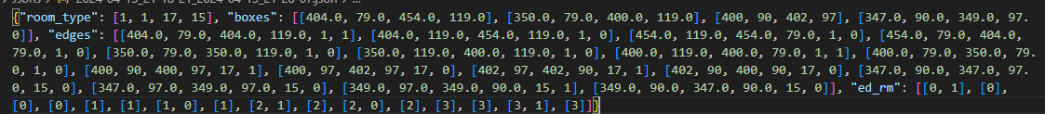
Challenges and Solution
Challenge: Post Training
Notes:
Explain about difficulties and unhuman structure

Slide 7
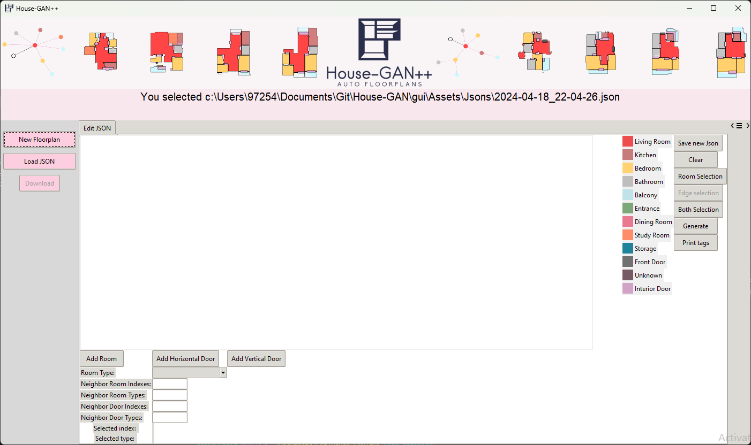
Challenges and Solution
Solution: Develop GUI Utility
Notes:
Handles all the problematic connections between edrm edges and boxes

Slide 8
Challenges and Solution
Challenge: Json Bugs
Json bugs floated till the very end of the development process due to inadequate comprehension of Json
Notes:
Emphesizes the problem of creating a dataset for post training

Slide 9
Challenges and Solution
Solution: Architecture
Our Architecture is composed of agile development and separation between GUI development and Json analysis

Slide 10
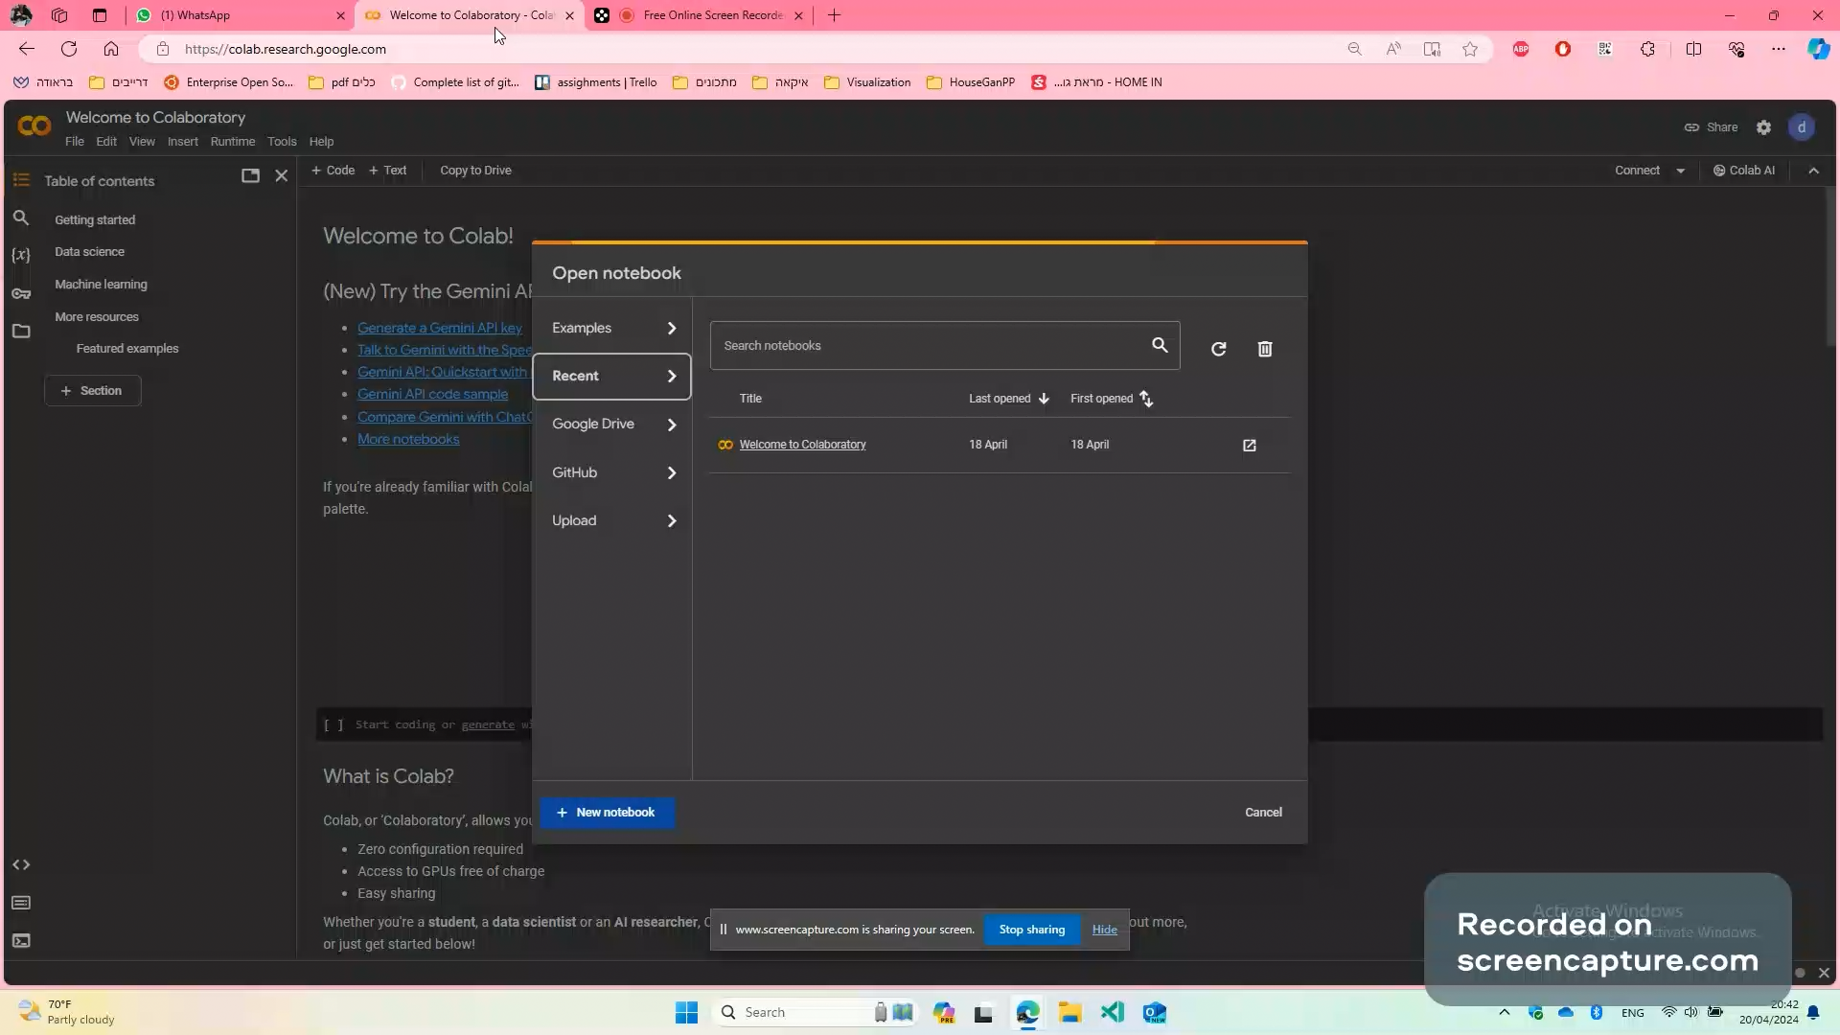
Challenge: Google Collab

Slide 11
Challenges and Solution
Solution: Migrating to Google Cloud
Video of button and receiving result

Slide 12
Challenges and Solution
Challenge: CUDA
Locally worked with CUDA
Then upgraded to Google Collab GPU
Then migrating to Google Cloud
Trying different services of Google Cloud:
Cloud Function
Cloud Run
Google VM
Kubernetes

Slide 13
Challenges and Solution
Solution: CPU
Change the code to work on CPU only, luckily, it does.

Slide 14
Architecture
CI/CD
Git
Google Cloud Build
Google Artifact Registery
2. Google Cloud Storage
3. Google Cloud Run
4. Agile Development
5. Separation Between Login(Json analysis) and GUI development.
Notes:
בעל פה

Slide 15
Testing Process
Model Testing
Test how the model handles different incomplete JSONs
2. GUI Testing
Test the validity of the generated json files and basic buttons of the GUI.
Notes:
בעל פה

Slide 16
Testing Process
Model Testing
Notes:
בעל פה

Slide 17
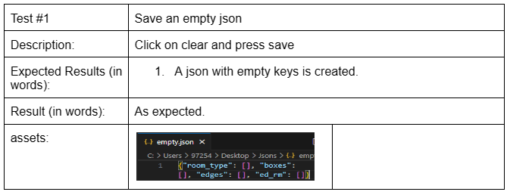
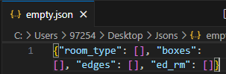
Testing Process
GUI Testing 1#
Notes:
בעל פה

Slide 18
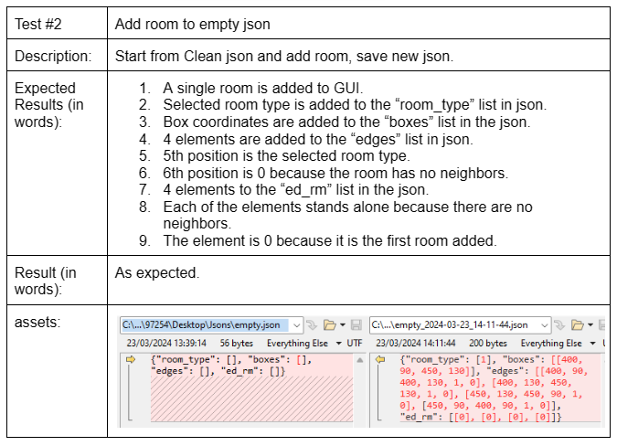
Testing Process
GUI Testing 2#
Notes:
בעל פה

Slide 19
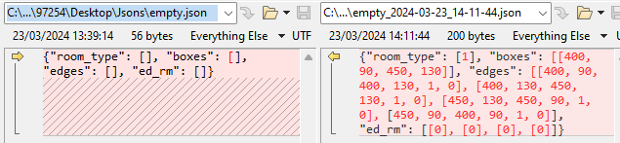
Testing Process
GUI Testing 2#
Notes:
בעל פה

Slide 20
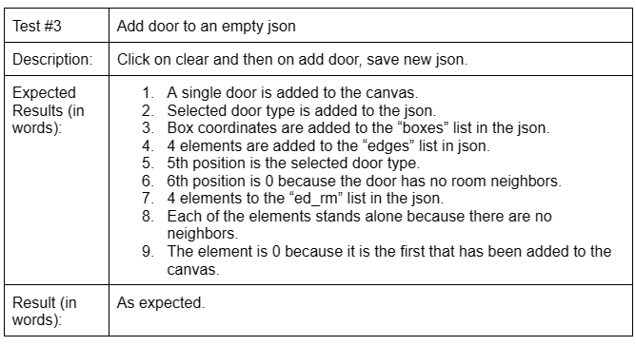
Testing Process
GUI Testing 3#
Notes:
בעל פה

Slide 21
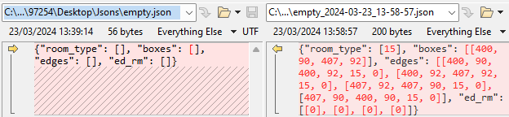
Testing Process
GUI Testing 3#
Notes:
בעל פה

Slide 22
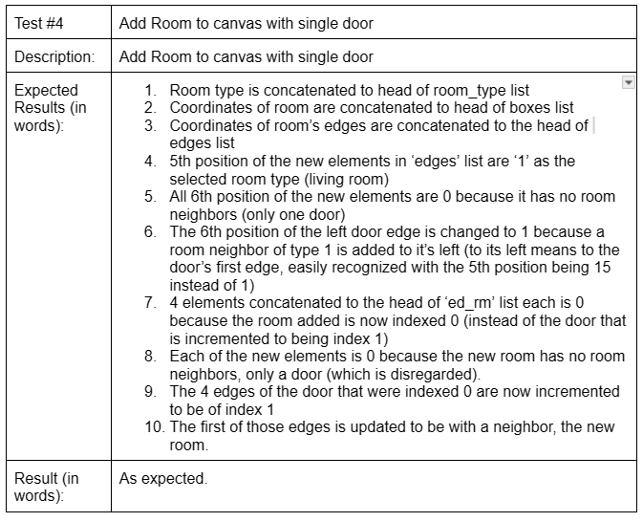
Testing Process
GUI Testing 4#
Notes:
בעל פה

Slide 23
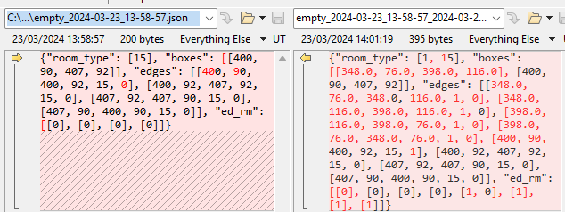
Testing Process
GUI Testing 4#
Notes:
בעל פה

Slide 24
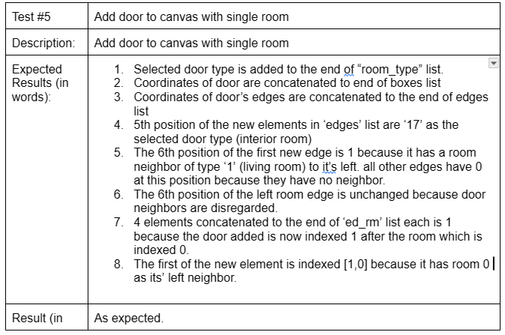
Testing Process
GUI Testing 5#
Notes:
בעל פה

Slide 25
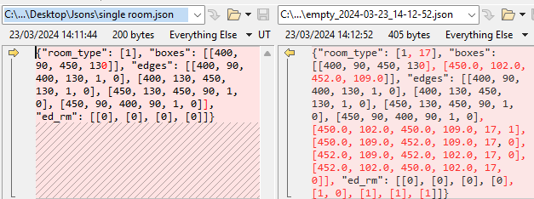
Testing Process
GUI Testing 5#
Notes:
בעל פה

Slide 26
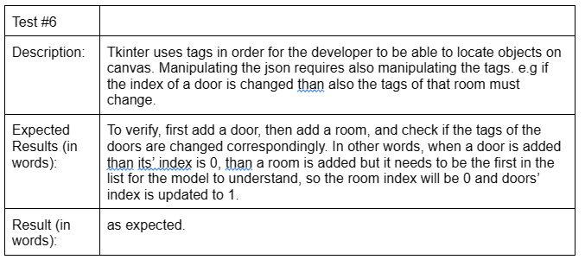
Testing Process
GUI Testing 6#
Notes:
בעל פה

Slide 27
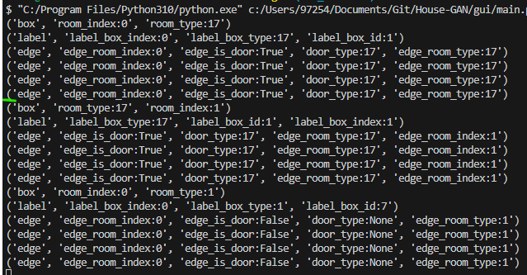
Testing Process
GUI Testing 6#
Notes:
בעל פה

Slide 28
Thank You

